Slide 1
DSA with Python
Session 6
By
Syed Jafer

Slide 2
Need of Data structures ?

Slide 3


Slide 4


Slide 5
Data Structure
Data structure is a particular way of storing and organizing data in a computer so that it can be used efficiently.

Slide 6
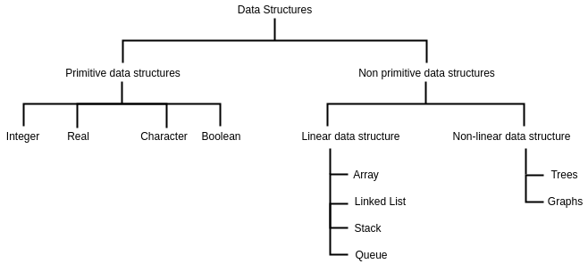
Abstract Data Types (ADTs)

Slide 7
Abstract Data Types (ADTs)
1. Declaration of data
2. Declaration of operations
Eg: Linked List.

Slide 8
What is an Algorithm ?

Slide 9
Analysis of Algorithm
Determining a running time of an algorithm ..
1. depends on how long it takes a computer to run the lines of code of the algorithm
2. depends on the speed of the computer,
3. depends on the programming language,

Slide 10
Asymptotic Notations

Slide 11
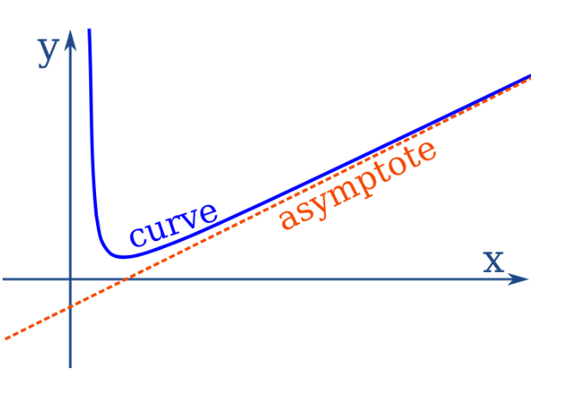

Slide 12
Userdefined Datastructures
users define how the Data Structure would work and define functions in it.
1. Stack
2. Queue
3. Tree
4. Linked List
5. Graph
6. HashMap

Slide 13
Agenda
List
    Declaring
    Indexing
    Modify – Mutable
    Adding Values
    Removing Values
    Sorting
    Copy

Slide 14
Lists
a data structure in Python that is a mutable, or changeable, ordered sequence of elements.

Slide 15
Lists - Declaring
[] - Square Brackets
list() - Constructor
data = [ ‘d1’, ‘d2’, ‘d3’ ]

Slide 16
Lists
Order is maintained
Changeable
Allow Duplicate Values

Slide 17
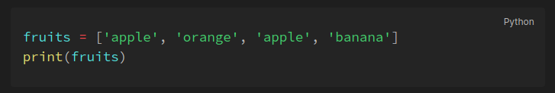
Lists – Allow Duplicates
Since lists are indexed, lists can have items with the same value:

Slide 18
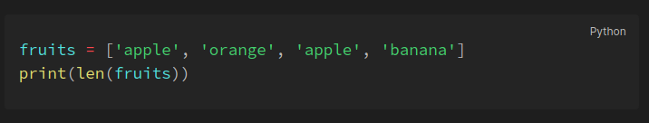
Lists – List Length
To determine how many items a list has, use the len() function

Slide 19
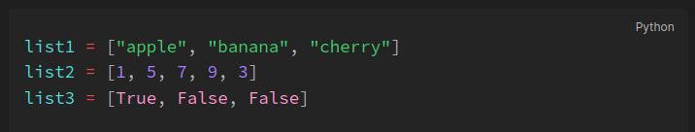
Lists – Data Types
List items can be of any data type or a combination of data types.

Slide 20
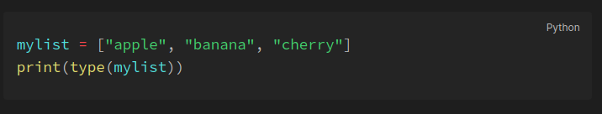
Lists – type()
lists are defined as objects with the data type 'list'

Slide 21
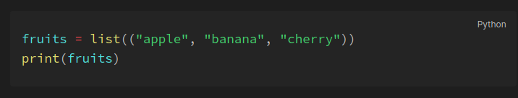
Lists – list() Constructor
It is also possible to use the list() constructor when creating a new list.

Slide 22
Lists – in & not in
In – Element present in the list.
Not in – Element not present in the list.

Slide 23
Lists – Indexing
List items are indexed, the first item has index `[0]`, the second item has index `[1]` etc.

Slide 24
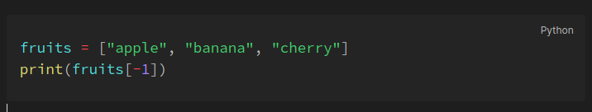
Lists – Negative Indexing
Negative indexing means start from the end. `-1` refers to the last item, `-2` refers to the second last item etc.

Slide 25
Lists – Range of Indexes
You can specify a range of indexes by specifying where to start and where to end the range.
When specifying a range, the return value will be a new list with the specified items.

Slide 26
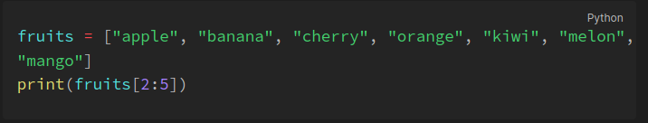
Lists – Range of Indexes

Slide 27
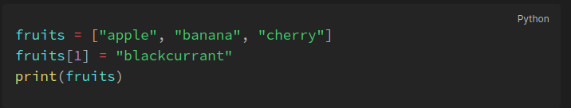
Lists – Change Values

Slide 28
Lists Method - insert()
Insert an item at a given position.
The first argument is the index of the element before which to insert.
a.insert(0, x) inserts at the front of the list, and a.insert(len(a), x) is equivalent to a.append(x).

Slide 29
Lists Method - append()
Add an element at the end of the list.
fruits = [‘apple’, ‘orange’, ‘banana’]
fruits.append(‘papaya’)

Slide 30
Lists Method - extend()
adds all the elements of an iterable (list, tuple, string etc.) to the end of the list.
fruits = [‘apple’, ‘orange’, ‘banana’]
fav_fruits = [‘papaya’, ‘pear’]
fruits.extend(fav_fruits)
print(fruits)

Slide 31
Lists Removal - remove()
remove(key) will remove the first occurrence of the key
fruits = [‘apple’, ‘orange’, ‘banana’, ‘appple’]
fruits.remove(‘apple’)
print(fruits)

Slide 32
Lists Removal - pop(index)
pop(index) will remove the specific index.
fruits = [‘apple’, ‘orange’, ‘banana’, ‘appple’]
fruits.pop(2)
print(fruits)

Slide 33
Lists Removal – del
Del will remove the specific index; also the entire list
fruits = [‘apple’, ‘orange’, ‘banana’, ‘appple’]
del fruits[2]
print(fruits)
del fruits
print(fruits)

Slide 34
Lists Removal – clear
Clears the entire list.
fruits = [‘apple’, ‘orange’, ‘banana’, ‘appple’]
fruits.clear()
print(fruits)

Slide 35
Lists Sorting – sort
Sorting: Default – Ascending.
states = ['Tamil Nadu', 'Kerala', 'Andra']
states.sort()
print(states)

Slide 36
Lists Sorting – sort
Sorting: For Descending - .sort(reverse=True)
states = ['Tamil Nadu', 'Kerala', 'Andra']
states.sort(reverse=True)
print(states)

Slide 37
Lists Sorting – CaseSensitive
Sorting: For Descending - .sort(reverse=True)
states = ['Tamil Nadu', 'Kerala', 'andra', ‘andaman’]
states.reverse()
print(states)

Slide 38
Lists Copy – Direct Assignment
states = ['Tamil Nadu', 'Kerala', 'andra', ‘andaman’]
states_copy = states
states.append(‘bihar’)
print(states)
print(states_copy)

Slide 39
Q & A

Slide 40
Next session
Date : November 12 (Nalikku)
Time : 10 IST
Link : same as today

